Slide 1

K18X001 Acoustic Chamber Testing
FOXCONN CPEG JBD_VN
2022/Feb/08

Slide 2
Establish the Team
Team Member
RD: Fu Chiang, Dean, Sean
Vendor: Aegis, 小K
TE: Mark Wu, Allan Pham, Jones

Slide 3
Contact Point
Project Management
Contact point:
company name and homepage : Booster Electronics Technology Co,LTD
home page: www.boostertech.cn
contact person name : Carmen Long (Project Management)
email address : carmen.long@bcd-autotest.com
phone number : (+86) 198-2033-1504

Slide 4
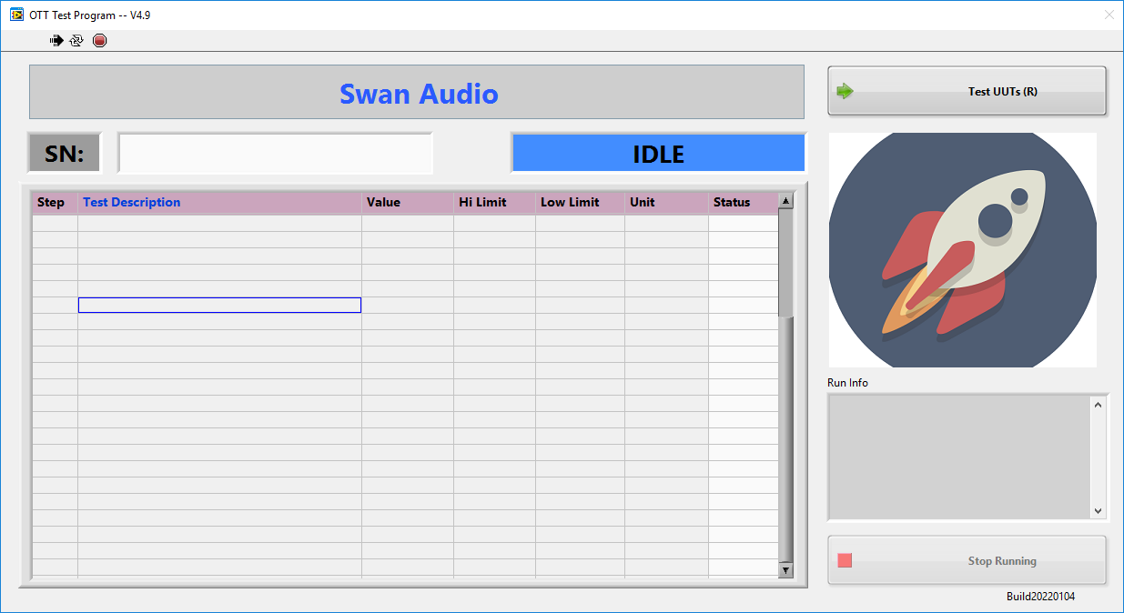
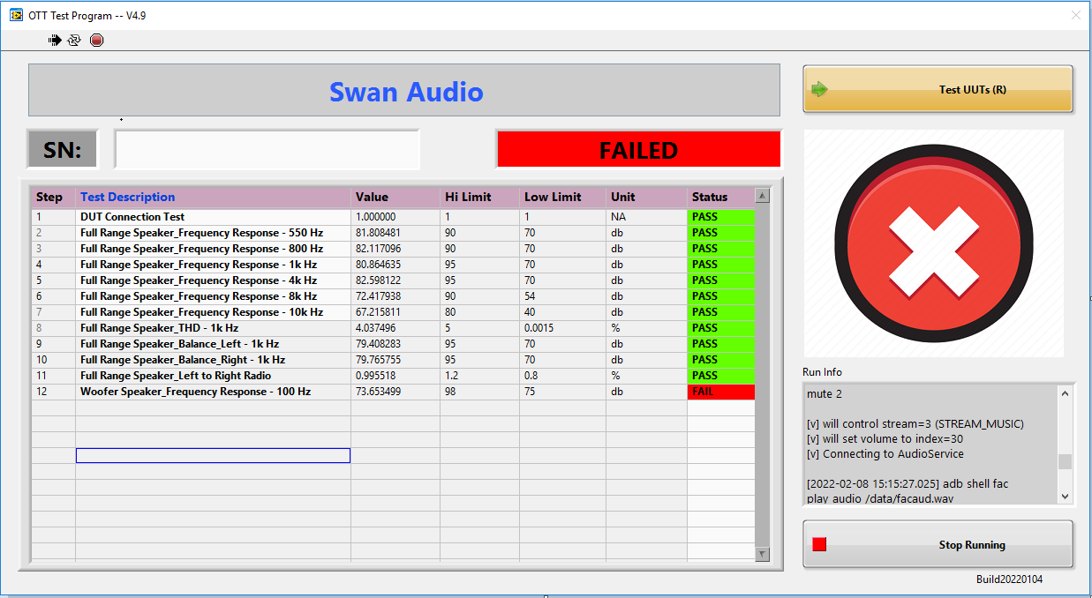
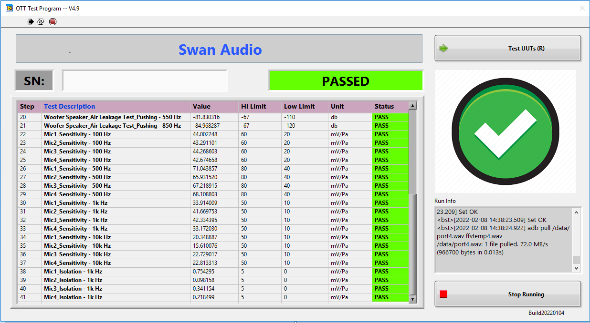
Acoustic Chamber Test Version
Test version 4.9
Build date 04-Jan-2022
IDLE Status
FAILED Status
PASSED Status

Slide 5
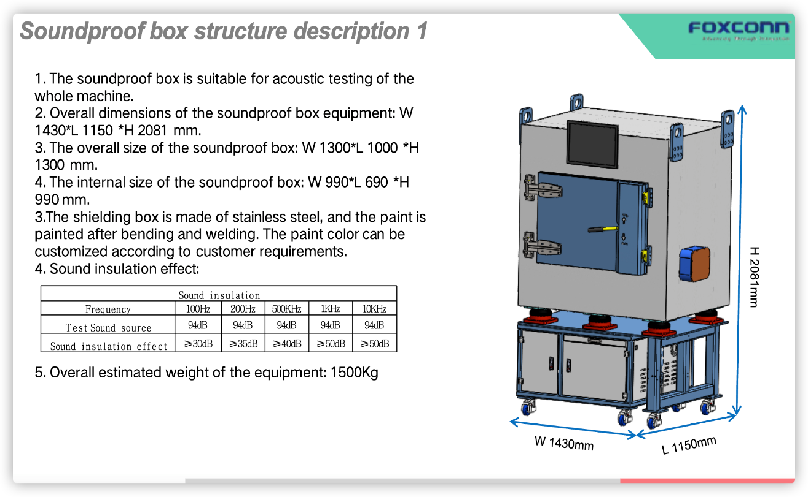
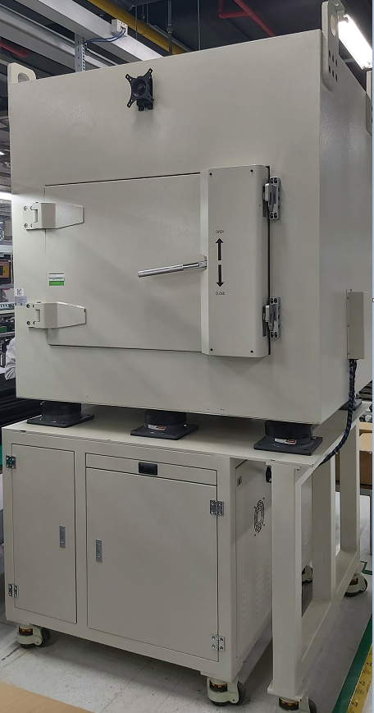
Acoustic Chamber Spec. Description
The overall size of the Acoustic Chamber: Width 1430mm, Length 1150mm, Height 2081mm
Actual weight: 1148kg.

Slide 6
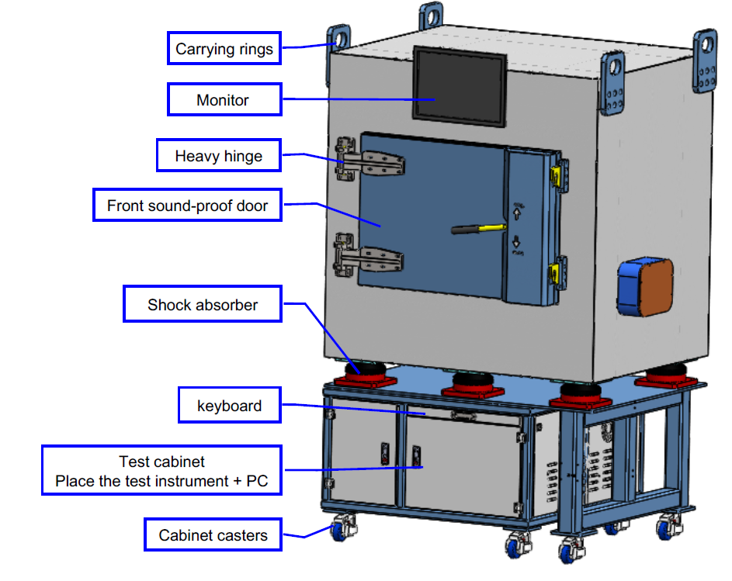
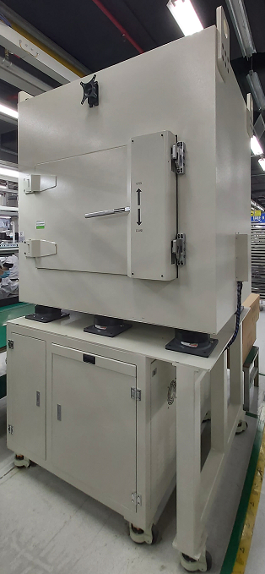
Acoustic Chamber structure description
1. The sound-proof cotton on the door is pointedthe
2. Add protective cover around the sound insulation cotton of the door panel.
3. Add mobile casters at the bottom of the audio test equipment.
4. The protective cover of the soundproof cotton on the door panel is completely surrounded
by the opening.

Slide 7
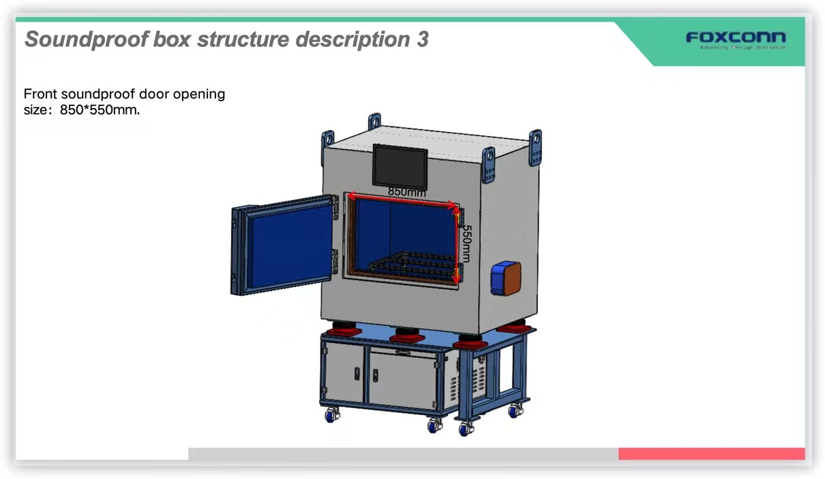
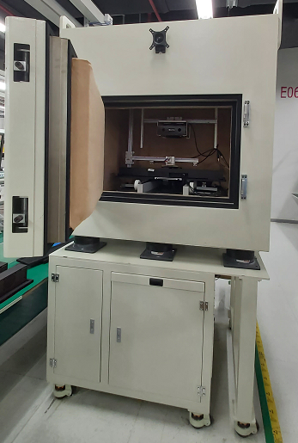
Acoustic Chamber – Manual Operation
The Acoustic Chamber door opening size: width 850mm, height 550mm.

Slide 8
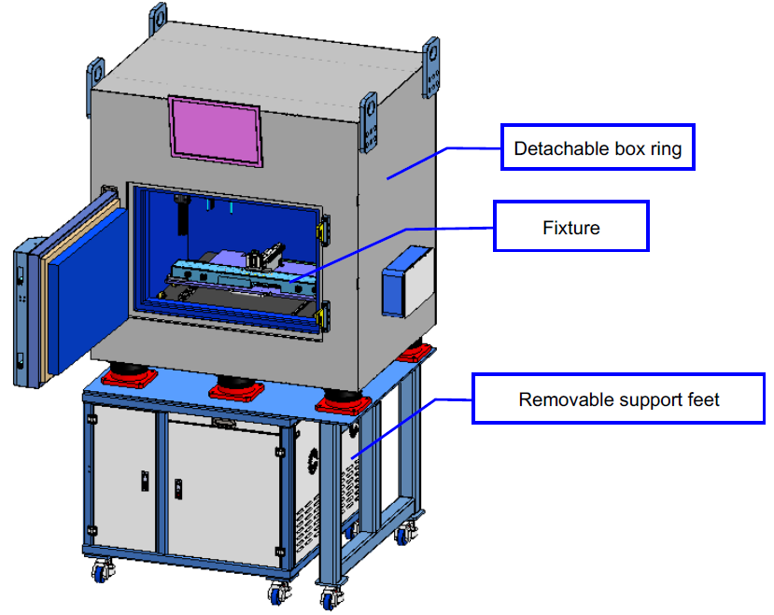
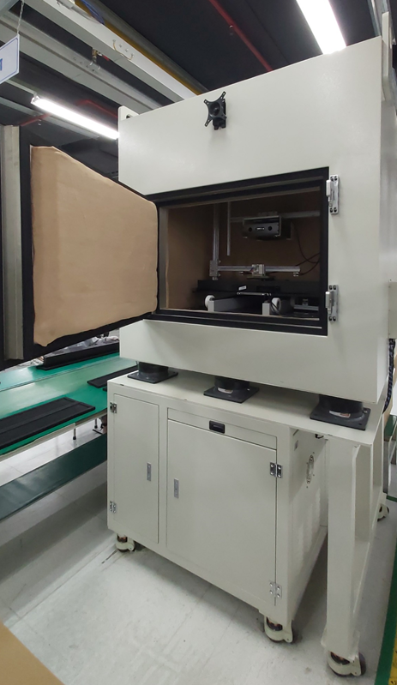
Acoustic Chamber -- Fixture Structure description
The Fixture structure in the Acoustic Chamber.

Slide 9
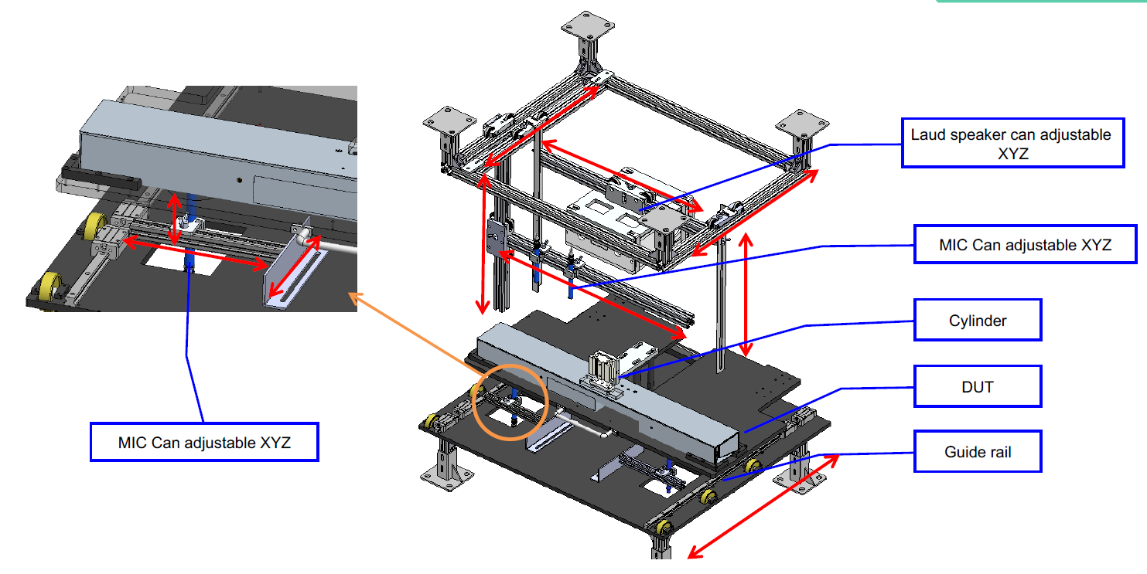
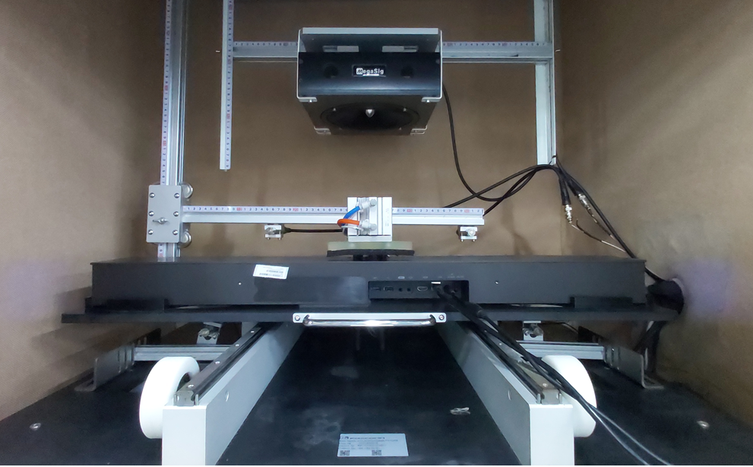
Acoustic Chamber -- Fixture Structure description
The Laud speaker and MIC structure in the Acoustic Chamber.

Slide 10
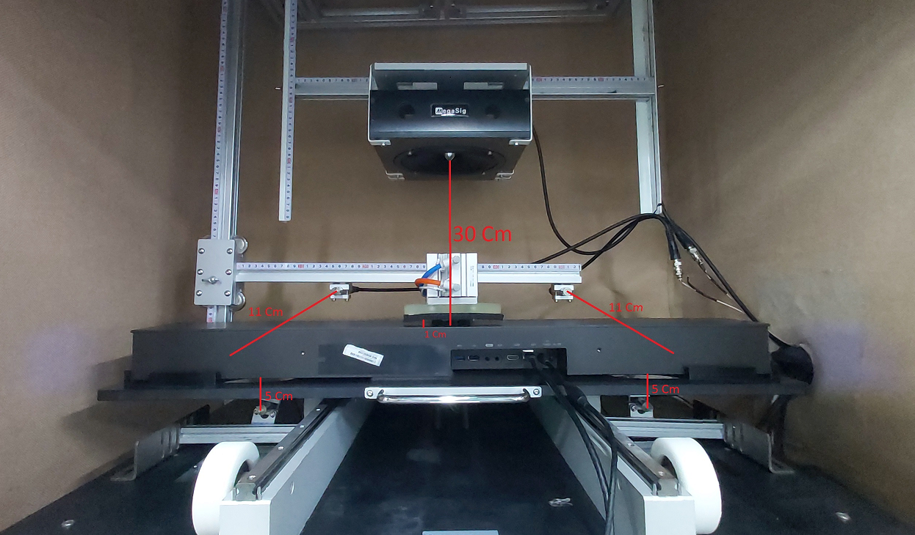
Acoustic Chamber Distance
The distance from Chamber’s speakers to SWAN’s Mics is about 30cm.
The distance from above Chamber’s Left/Right Mics to Left/Right SWAN’s Full Range Speakers is about 11cm.
The distance from under Chamber’s Left/Right Mics to Left/Right SWAN’s Woofer Speakers is about 5cm.

Slide 11
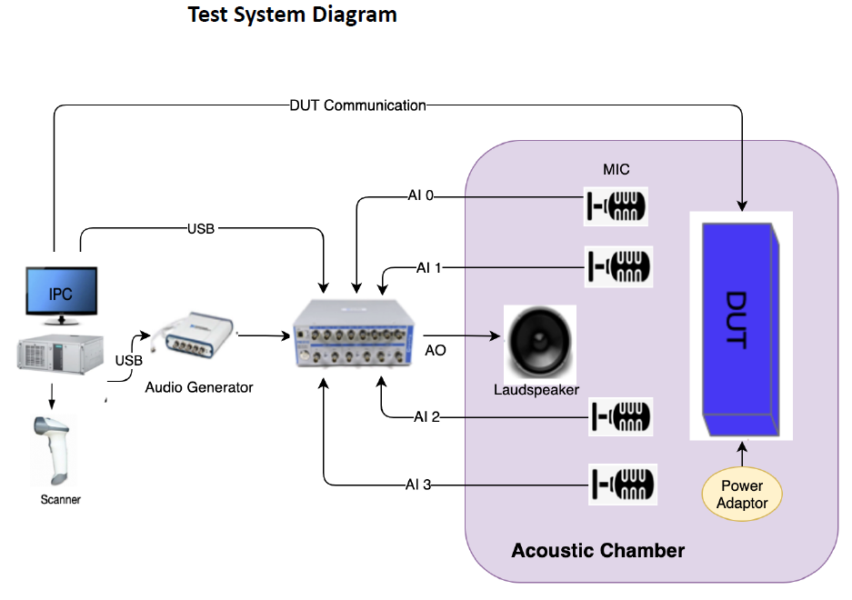
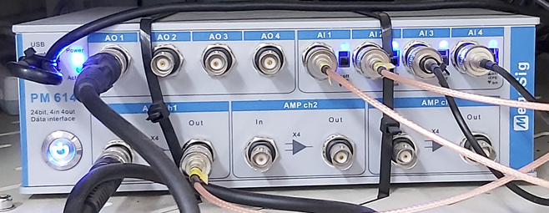
Acoustic Chamber Test Structure Proposal
Test Coverage Test System Diagram
  § MIC frequency response
  § MIC Harmonic Distortion
  § MIC sensitivity
  § MIC isolation test (1K)
  § SPK frequency response
  § SPK Harmonic Distortion
  § SPK Rub & Buzz
  § SPK R/L Balance
Test Equipment
§ IPC with monitor, Keyboard & Mouse
§ barcode scanner – Honeywell 1900
§ DC Power adaptor –Customer consign
§ Audio Generator – NI USB-4431
§ Laudspeaker -- Customize
§ Audio amplifier & Analyzer – MegaSig PM 6143
§ MIC – GRAS 40 pp * 4
§ Acoustic Chamber
§ Test Fixture
§ Test Control PCBA
Test Software
§ Labview
§ NI Sound & Vibration Toolkit
Sound analysis equipment

Slide 12
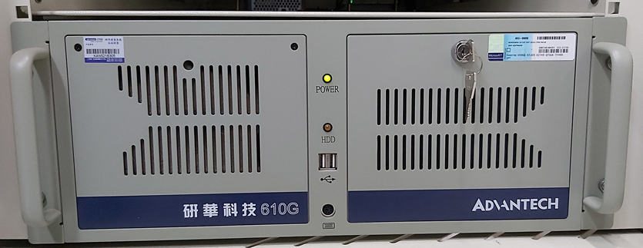
Acoustic Chamber Test Structure Proposal
Re-use equipment:
• Test PC
• Acoustic chamber
• Audio generator, NI USB-4431
• Audio amplifier & Analyzer – MegaSig PM 6143
• MIC – GRAS 40 pp * 2
• barcode scanner – Honeywell 1900
Items to be changed:
• Re-design/fabricate a new test fixture inside the acoustic chamber to support the new model
of products.
• Add 2 new MIC(GRAS 40pp) to test 4 SPK of the new model of product.
• Re-develop new test software to test the new model of product.
Test PC

Slide 13

Acoustic Chamber Test Functions
No | Test Title | Test Spec | Test Time(s)
1 | DUT Connection Test | (1, 1) | 0.638
2 | Full Range Speaker_Frequency Response - 550 Hz | (70, 90) db | 22.804
3 | Full Range Speaker_Frequency Response - 800 Hz | (70, 90) db | 0
4 | Full Range Speaker_Frequency Response - 1k Hz | (70, 95) db | 0
5 | Full Range Speaker_Frequency Response - 4k Hz | (70, 95) db | 0
6 | Full Range Speaker_Frequency Response - 8k Hz | (54, 90) db | 0
7 | Full Range Speaker_Frequency Response - 10k Hz | (40, 80) db | 0
8 | Full Range Speaker_THD - 1k Hz | (0.0015, 5) % | 0
9 | Full Range Speaker_Balance_Left - 1k Hz | (70, 95) db | 11.033
10 | Full Range Speaker_Balance_Right - 1k Hz | (70, 95) db | 11.125
11 | Full Range Speaker_Left to Right Radio | (0.8, 1.2) % | 0
12 | Woofer Speaker_Frequency Response - 100 Hz | (75, 98) db | 17.863
13 | Woofer Speaker_Frequency Response - 400 Hz | (80, 98) db | 0
14 | Woofer Speaker_Frequency Response - 550 Hz | (70, 98) db | 0
15 | Woofer Speaker_THD - 400 Hz | (0.0015, 5) % | 0
16 | Woofer Speaker_Balance_Left - 400 Hz | (80, 120) db | 9.425
17 | Woofer Speaker_Balance_Right - 400 Hz | (80, 120) db | 9.397
18 | Woofer Speaker_Left to Right Radio | (0.7, 1.4) % | 0
19 | Woofer Speaker_Air Leakage Test - 50 Hz | (48, 52) Hz | 9.452
20 | Woofer Speaker_Air Leakage Test_Pushing - 550 Hz | (-110, -67) db | 9.381
21 | Woofer Speaker_Air Leakage Test_Pushing - 850 Hz | (-120, -67) db | 9.381

Slide 14
Acoustic Chamber Test Functions
No | Test Title | Test Spec | Test Time(s)
22 | Mic1_Sensitivity - 100 Hz | (20, 60) mV/Pa | 20.773
23 | Mic2_Sensitivity - 100 Hz | (20, 60) mV/Pa | 3.276
24 | Mic3_Sensitivity - 100 Hz | (20, 60) mV/Pa | 3.265
25 | Mic4_Sensitivity - 100 Hz | (20, 60) mV/Pa | 3.263
26 | Mic1_Sensitivity - 500 Hz | (40, 80) mV/Pa | 20.987
27 | Mic2_Sensitivity - 500 Hz | (40, 80) mV/Pa | 3.409
28 | Mic3_Sensitivity - 500 Hz | (40, 80) mV/Pa | 3.39
29 | Mic4_Sensitivity - 500 Hz | (40, 80) mV/Pa | 3.367
30 | Mic1_Sensitivity - 1k Hz | (10, 50) mV/Pa | 20.95
31 | Mic2_Sensitivity - 1k Hz | (10, 50) mV/Pa | 3.258
32 | Mic3_Sensitivity - 1k Hz | (10, 50) mV/Pa | 3.298
33 | Mic4_Sensitivity - 1k Hz | (10, 50) mV/Pa | 3.235
34 | Mic1_Sensitivity - 10k Hz | (10, 50) mV/Pa | 21.035
35 | Mic2_Sensitivity - 10k Hz | (10, 50) mV/Pa | 3.25
36 | Mic3_Sensitivity - 10k Hz | (10, 50) mV/Pa | 3.244
37 | Mic4_Sensitivity - 10k Hz | (10, 50) mV/Pa | 3.251
38 | Mic1_Isolation - 1k Hz | (0, 5) mV/Pa | 20.967
39 | Mic2_Isolation - 1k Hz | (0, 5) mV/Pa | 3.255
40 | Mic3_Isolation - 1k Hz | (0, 5) mV/Pa | 3.272
41 | Mic4_Isolation - 1k Hz | (0, 5) mV/Pa | 3.267

